Slide 1
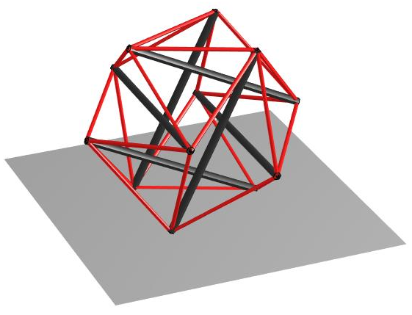
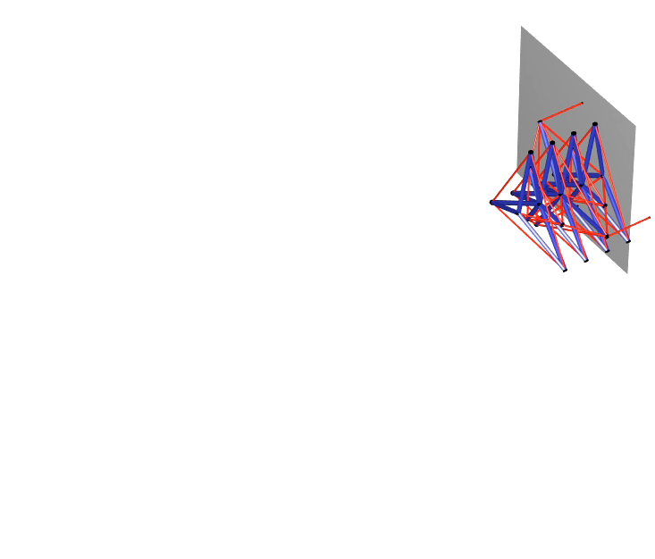
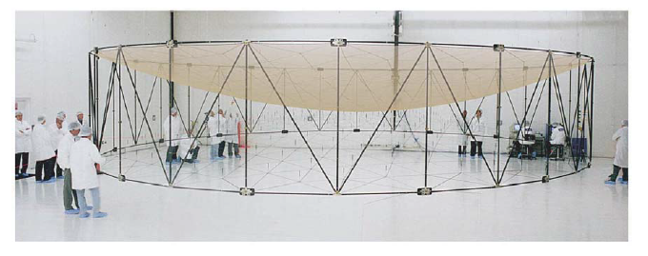
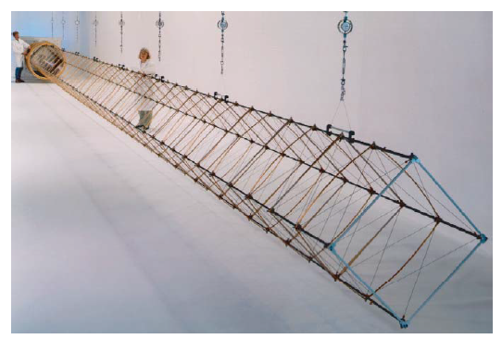
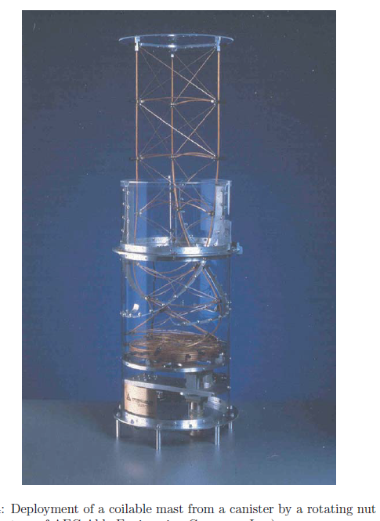
Tensegrity Systems - Stable network of axially loaded bars and strings
Minimal mass: As all the members are axially loaded, there is no bending in the material, results in mass- efficient designs. Minimum mass for the 5 fundamental structural loading.
Reliable dynamic models: The one-dimensional loading condition of each member leads to very accurate models of both static and dynamic models.
Mimics biological movement: Energy and mass efficient designs from evolution which mimics animal movement by pulling strings (tendons), putting rigid bones (bars) in compression, rather than using toque motors at joints.
Adjustable compliance: It can change its stiffness without changing its external shape and can also change it shape without changing its stiffness. Ideal for designing soft robots.
Distributed sensing and actuation: Each of the tensile members can serve as sensors and actuators.
No hysteresis within the structure: Prestress can prevent load reversals which cause hysteresis, a major challenge to precision control.
Planetary Lander
Deployable Antenna
Deployable Lunar Tower
/ Deformable Robotic Arm
Deployable reflector antenna
(M. W. Thomson and
TRW Astro Aerospace)
Deployable Mast to support solar arrays on
ISS (AEC-Able Engineering Company, Inc.)

Slide 2
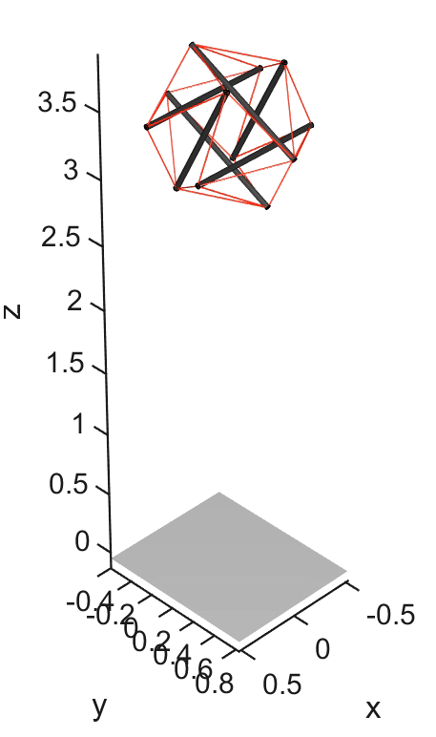
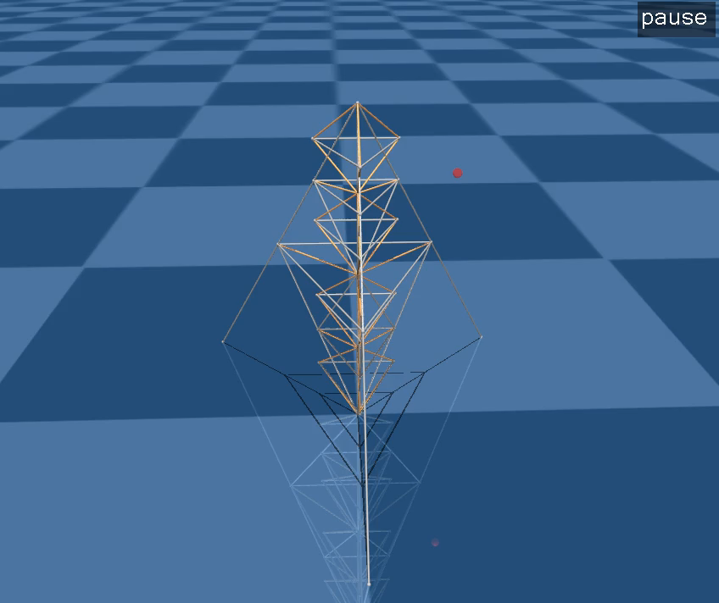
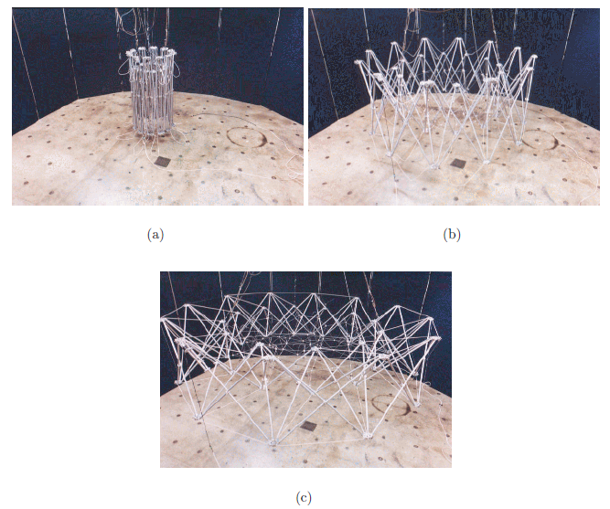
Tensegrity Systems
Deployable reflector antenna
(Z. You and S. Pellegrino (CALTech))
Planetary Lander

